Slide 1

Vivekanand College, Kolhapur (Empowered Autonomous) Department of Computer Science B.Sc. III (Computer Science) 2023-24
Submitted by:
1.Priya Shivling Koneri .
2.Supriya Krishnat Kumbhar .
3.Pradnya Arun Mali .
4.Mrunali Maruti Patil .

Slide 2
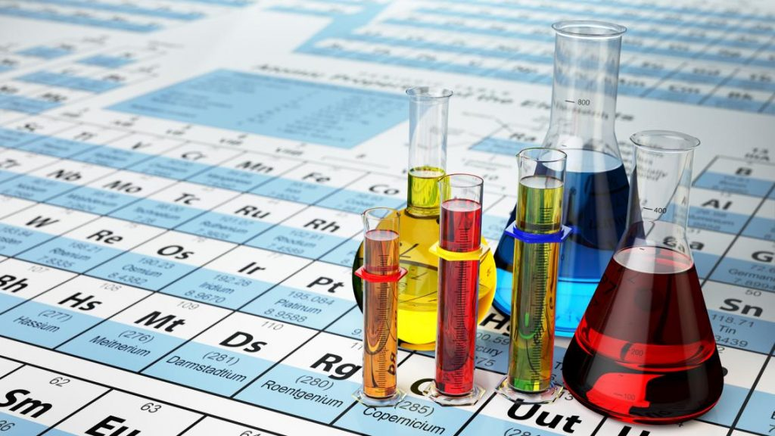
“ Green Metrics Predictor”

Slide 3
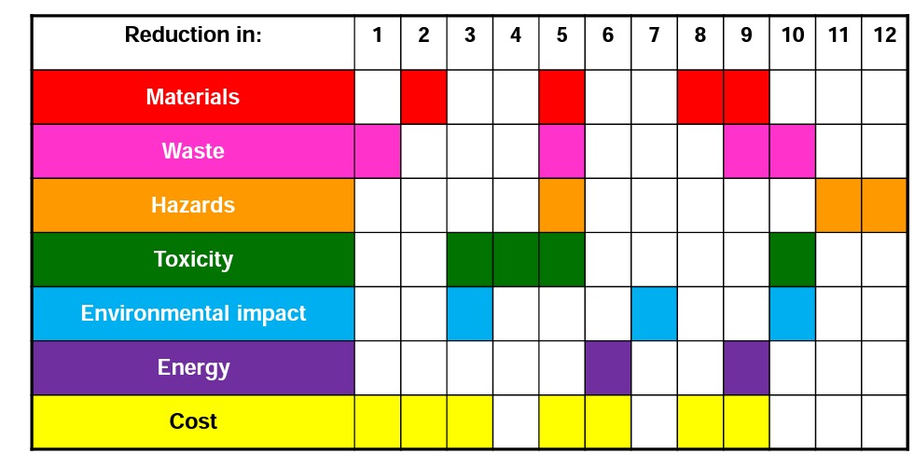
WHAT IS GREEN METRICS ?
The " Green Metrics Predictor" is a visionary software project designed to calculate green metrics easily

Slide 4
The chemistry department is conducting research on “GREEN METRICS” and the difficult part of their research is to do 15-20 calculations for each product So, with this project we are going to create a software which will make these calculations easier and faster. Green chemistry metrics describe aspects of a chemical process relating to the principles of Green Chemistry.
One of the key advantages of the Green Metrics Predictor is its ability to save valuable time. Traditionally, calculating green metrics, such as carbon emissions, water usage, energy consumption, and waste generation, can be a time-consuming and labor-intensive process.
The Green Metrics Predictor automates these tasks, significantly reducing the time and effort required for these calculations.

Slide 5
OBJECTIVES
To measure the efficiency and environmental performance of chemical processes.
To find the efficiency and yields of the multi-component reaction.
To minimize errors while performing green metrics calculation manually.
To compare the various chemical processes and to choose best among them for further experimentation.
To represent chemical process data graphically for better analysis.

Slide 6
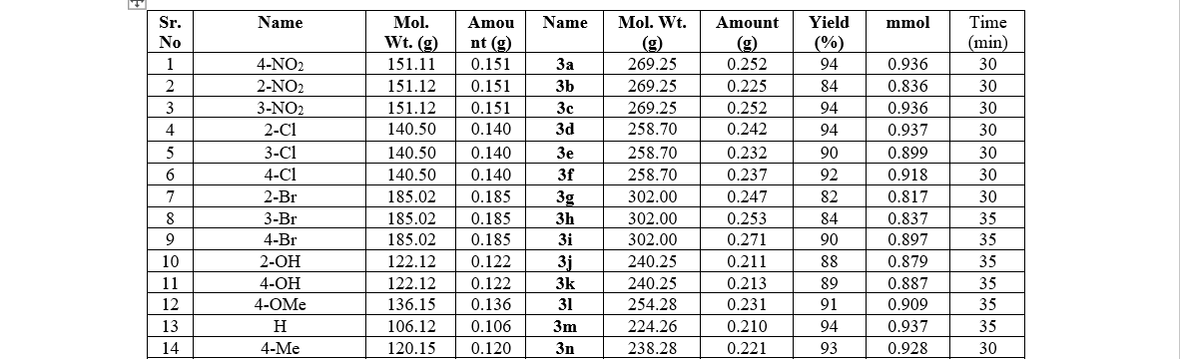
Database of Reagents and Products

Slide 7
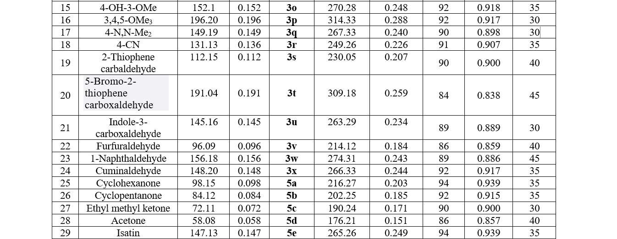

Slide 8
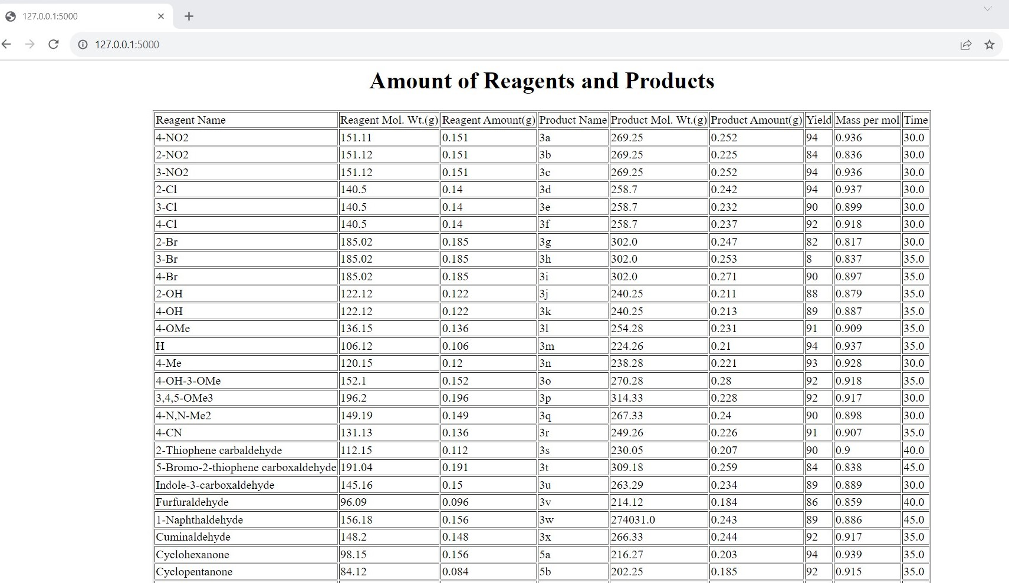

Slide 9
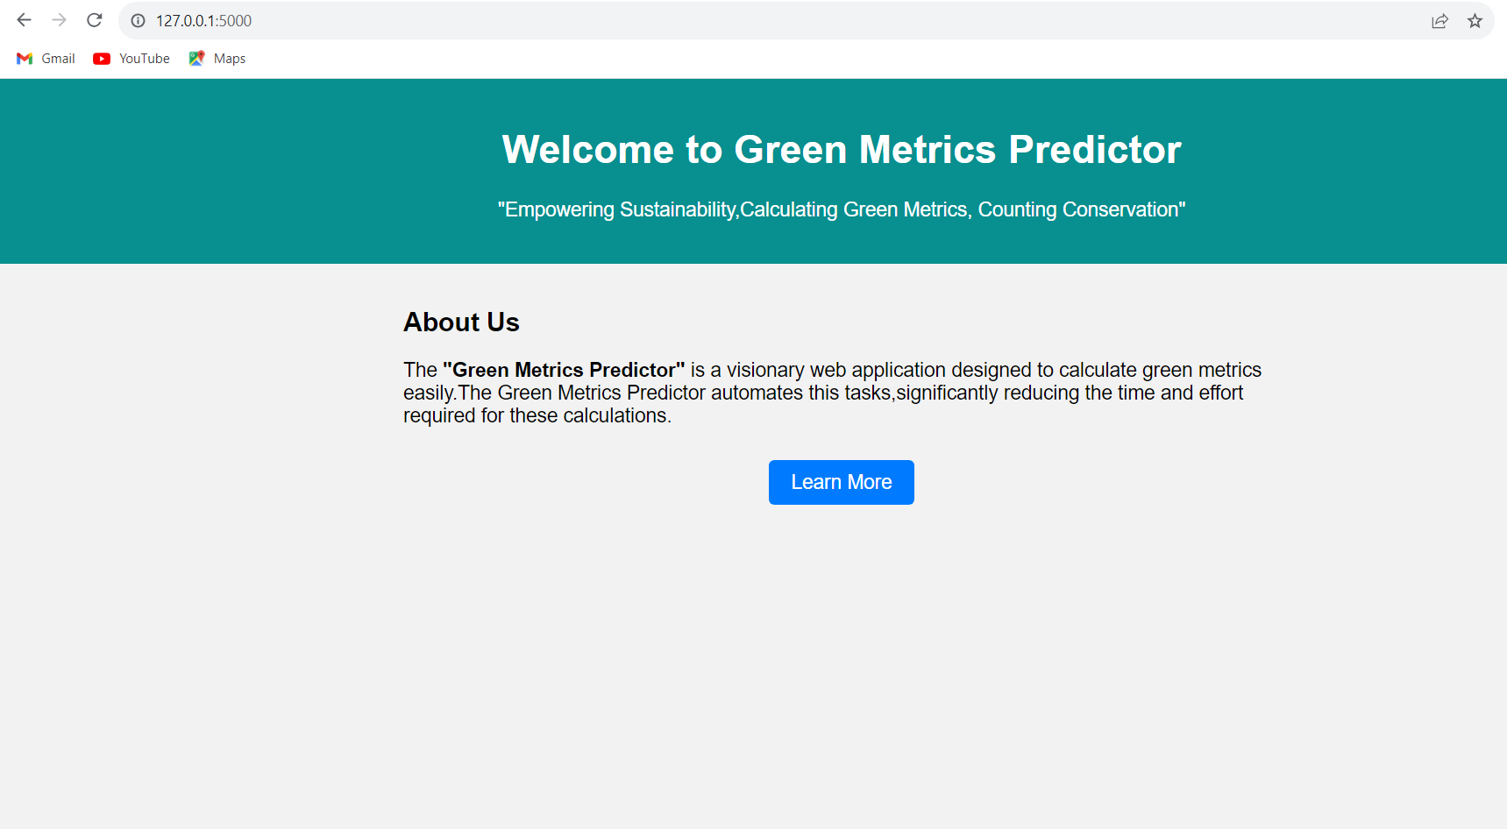

Slide 10
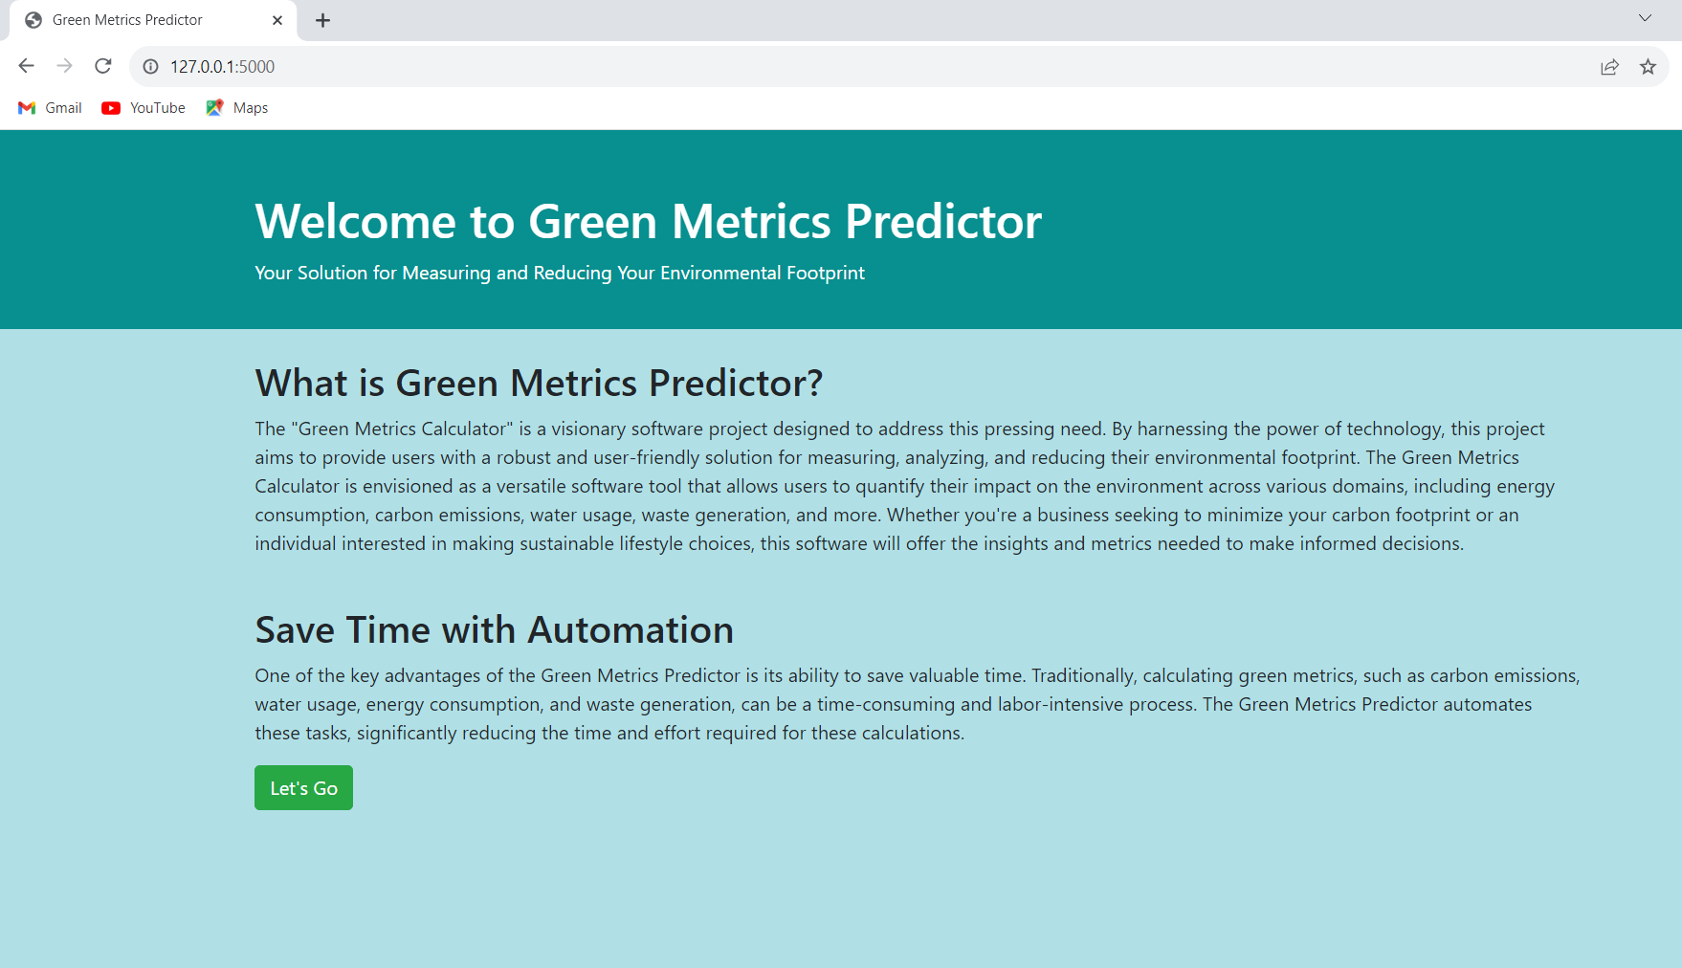

Slide 11
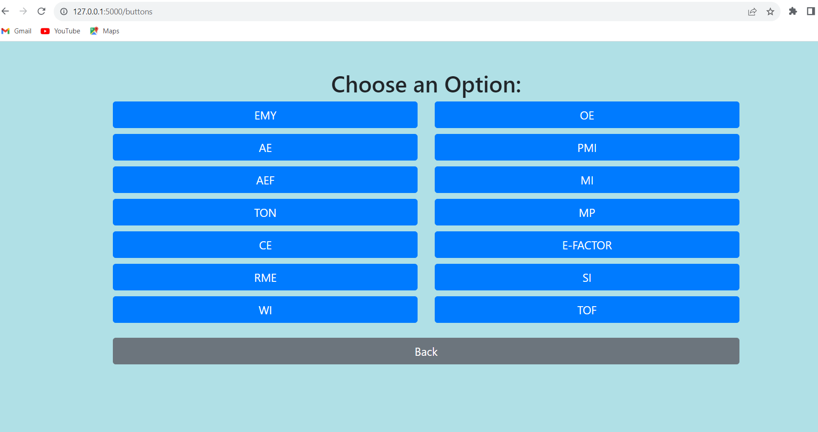

Slide 12
Calculation of green metrics for the model reaction :

Slide 13
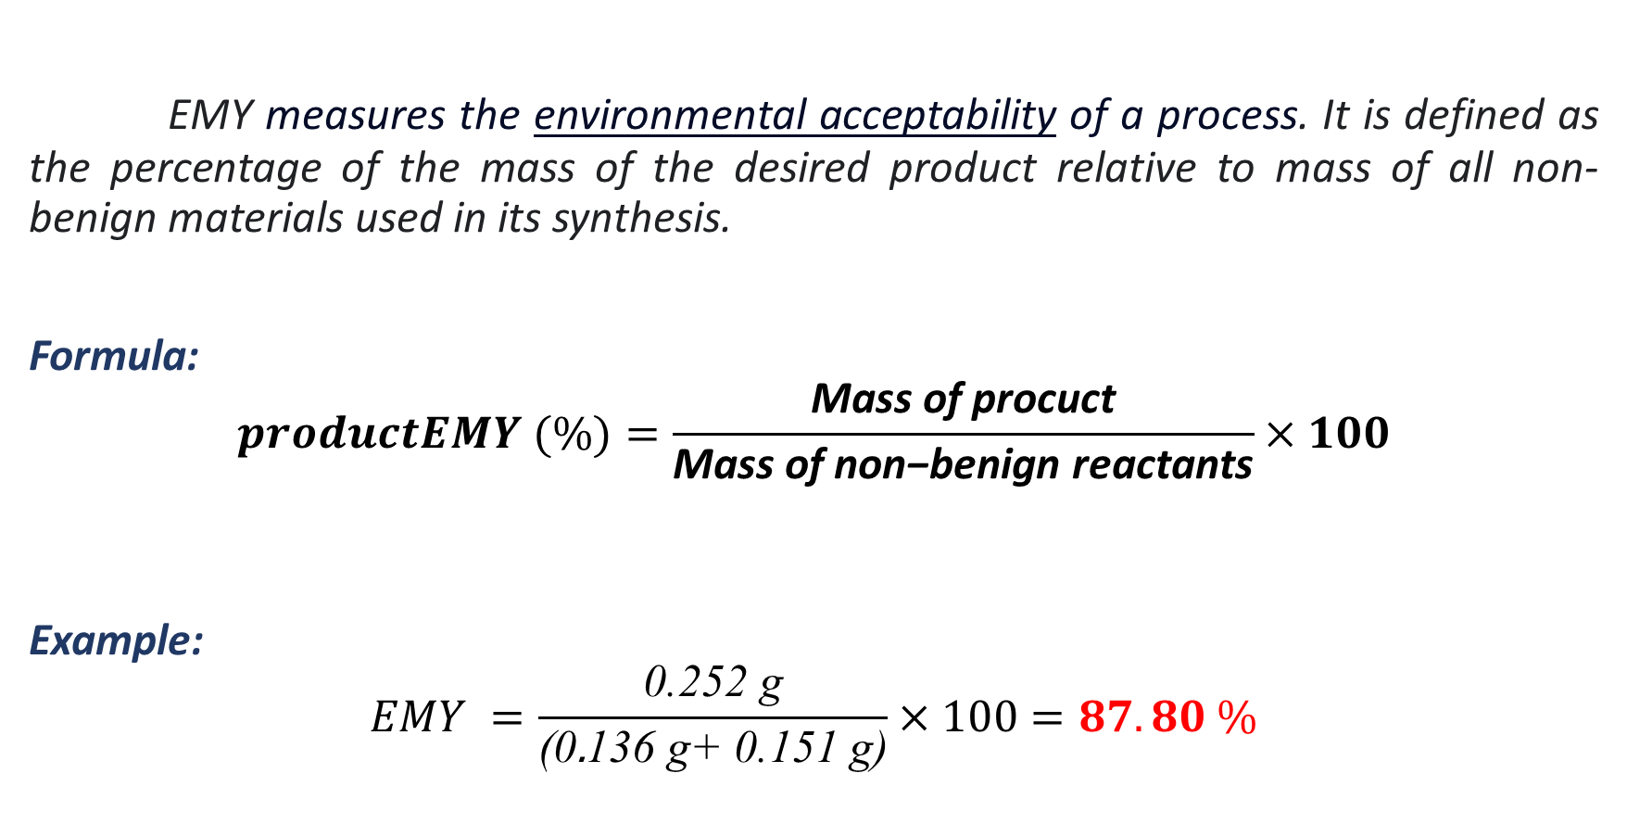
Effective Mass Yield (EMY) :
EMY measures the environmental acceptability of a process. It is defined as the percentage of the mass of the desired product relative to mass of all non-benign materials used in its synthesis.
Formula:
$$productEMY (\%)=\frac{\text{Mass} \text{of} \text{procuct}}{\text{Mass} \text{of} \text{non}\text{−}\text{benign} \text{reactants}}×100$$
Example:
$$EMY =\frac{\text{0.252 }\text{g}}{\text{(0}\text{.}\text{136 }\text{g}\text{+ 0.151 }\text{g}\text{)}}×100=87.80 \%$$

Slide 14
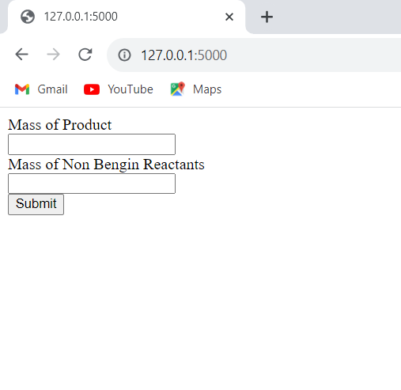
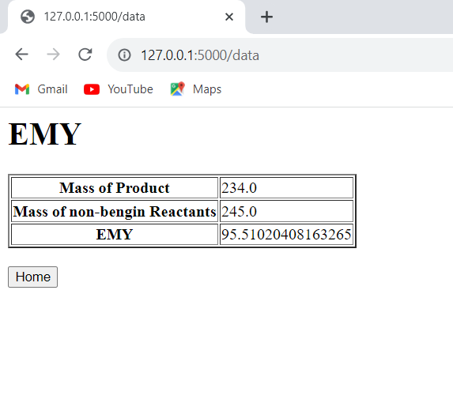
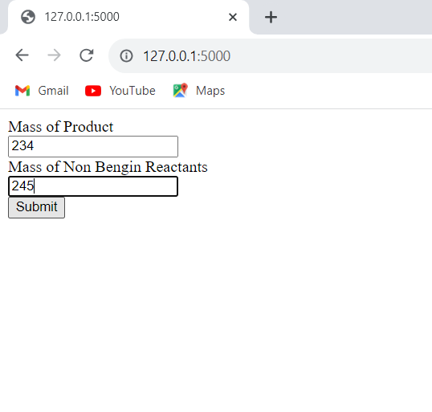

Slide 16
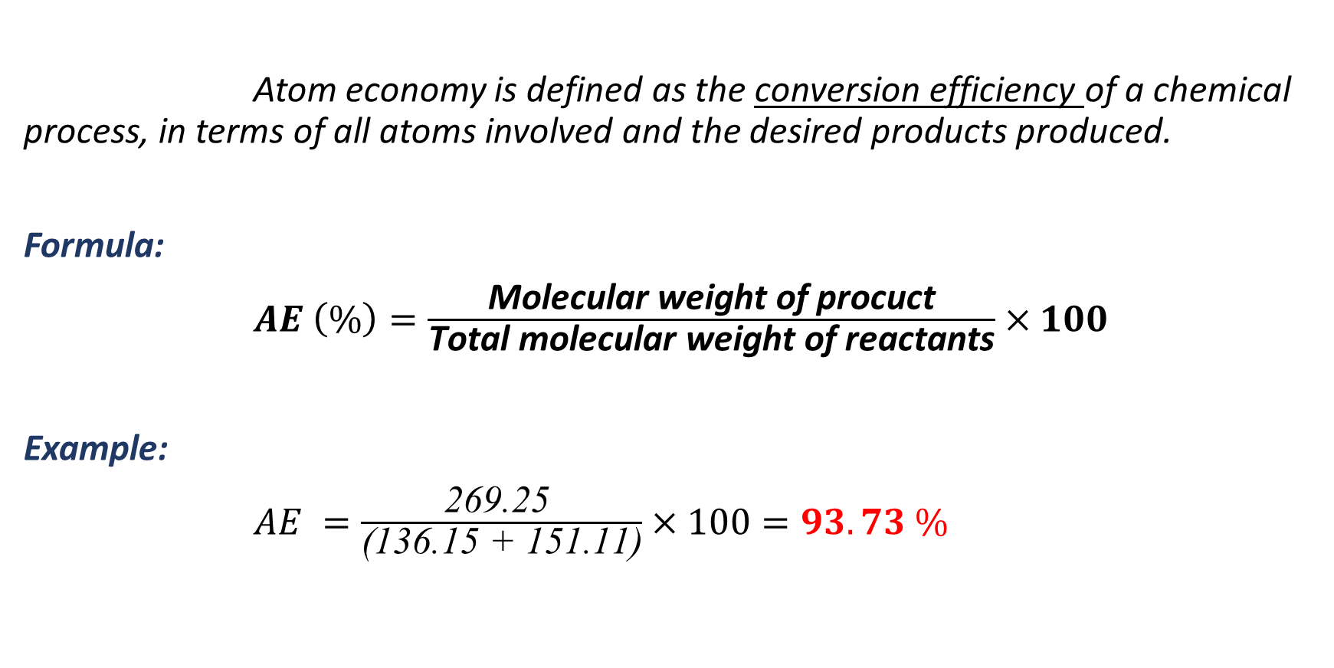
Atom Economy (AE):-
Atom economy is defined as the conversion efficiency of a chemical process, in terms of all atoms involved and the desired products produced.
Formula:
$AE \left(\%\right)=\frac{\text{Molecular} \text{weight} \text{of} \text{procuct}}{\text{Total} \text{molecular} \text{weight} \text{of} \text{reactants}}×100$
Example:
$AE =\frac{\text{269.25 }}{\text{(136.15 + 151.11)}}×100=93.73 \%$

Slide 17
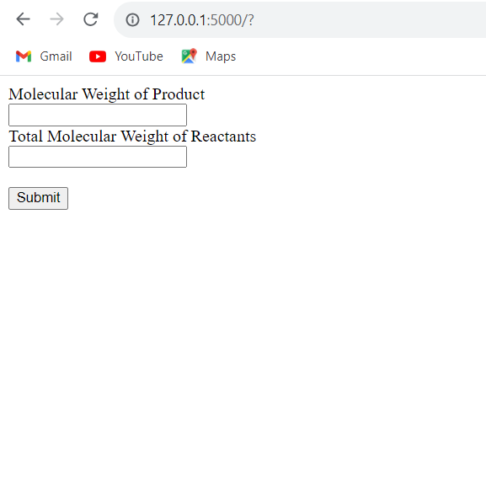
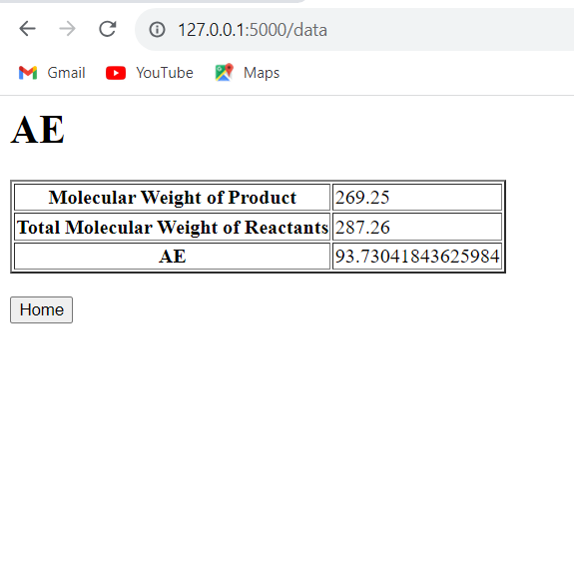
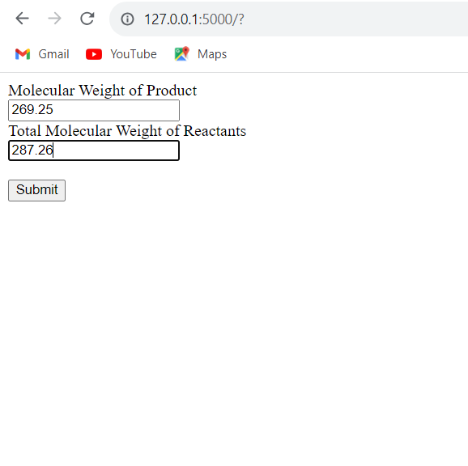

Slide 19
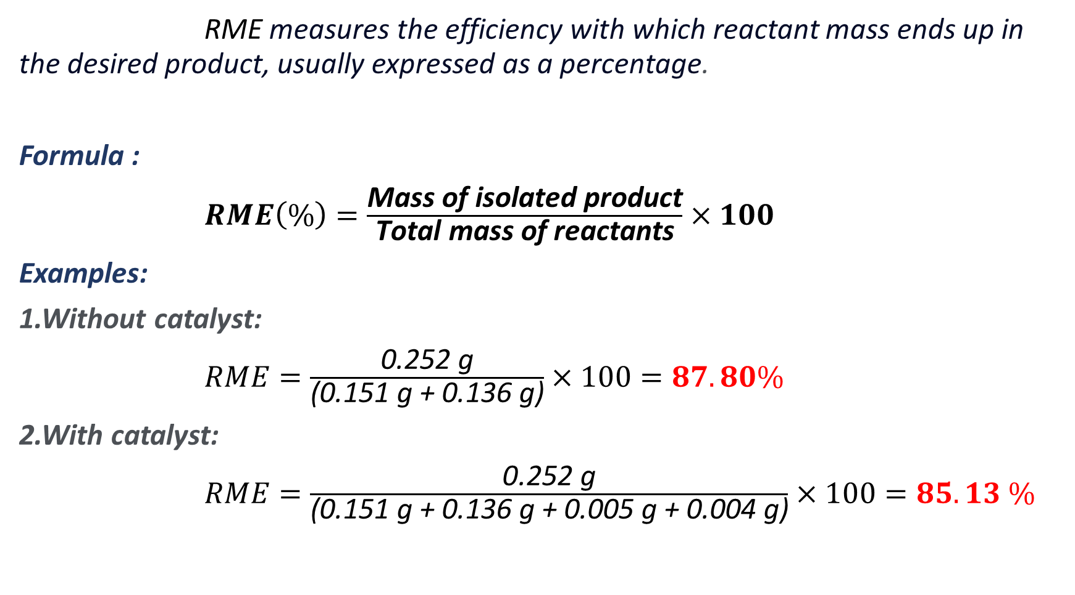
Reaction Mass Efficiency (RME) :-
RME measures the efficiency with which reactant mass ends up in the desired product, usually expressed as a percentage.
Formula :
$RME\left(\%\right)=\frac{\text{Mass} \text{of} \text{isolated} \text{product}}{\text{Total} \text{mass} \text{of} \text{reactants}}×100$
Examples:
1.Without catalyst:
$RME=\frac{\text{0.252 }\text{g}}{\text{(0.151 }\text{g}\text{ + 0.136 }\text{g}\text{)}}×100=87.80\%$
2.With catalyst:
$RME=\frac{\text{0.252 }\text{g}}{\text{(0.151 }\text{g}\text{ + 0.136 }\text{g}\text{ + 0.005 }\text{g}\text{ + 0.004 }\text{g}\text{)}}×100=85.13 \%$

Slide 20
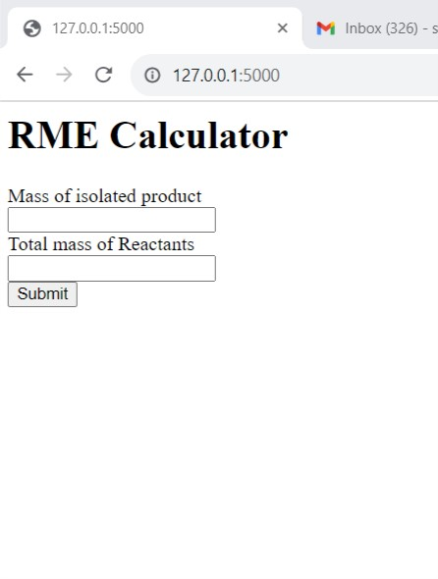
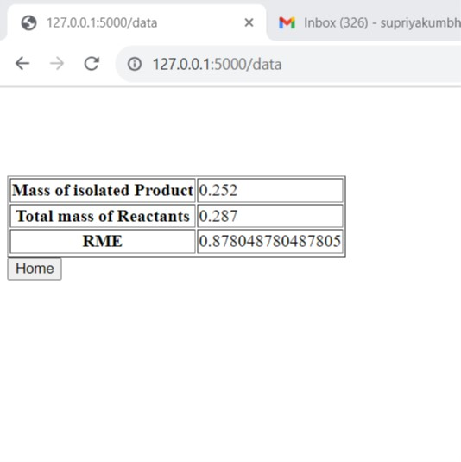
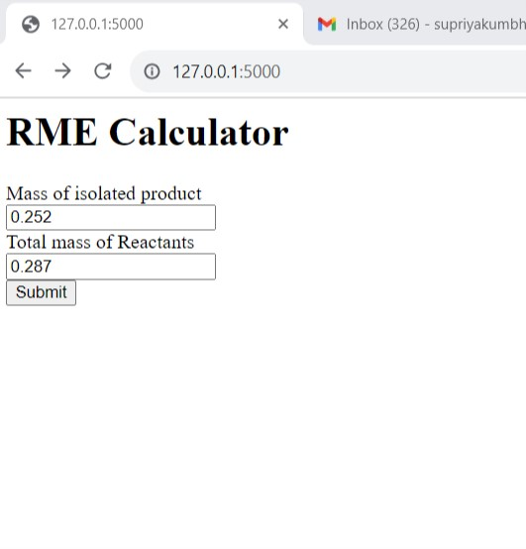

Slide 21
Conclusion
In conclusion, the “Online Green Metrics Calculator” stands as an indispensable tool for efficiently calculating and tracking green metrics while saving valuable time.
The Online Green Metrics Calculator not only facilitates accurate and rapid calculations but also encourages a proactive approach to environmental responsibility.

Slide 22
